Slide 1

Car Accident Analysis and Severity Prediction

Slide 2
Background
Road traffic accidents are a major source of human and economic hardship in most advanced economies, with consequences which can range from minor property/vehicular damage, to major damage, personal injury or death. It is estimated that road traffic accidents cost the United States’ economy ∼ $810 billion per year, including costs due to property damage, legal costs and associated medical bills [1]. It is therefore of paramount importance that we understand the factors influencing the likelihood of a road traffic accident occuring at a given location, as well as those which influence the severity of those accidents that do occur.
The data for this project is available on the below mentioned link
http://data-seattlecitygis.opendata.arcgis.com/datasets/5b5c745e0f1f48e7a53acec63a0022ab_0

Slide 3
Importance of Analyzing Traffic Accidents
Accurately analyzing accidents can help governments to better the safety of their roads and highways.
Identifying high areas of accidents and high areas of accident severity can highlight areas of concern.
It can also be beneficial to insurance companies looking to change their rates in different areas.

Slide 4
Agenda
The goal of this project is to investigate and determine what causes accidents and what attributes to their level of severity.
Through visualizations and machine learning algorithms, areas of concern will be highlighted, and the seriousness of accidents will be predicted as accurately as possible.

Slide 5
Research Questions
What are the limitations of the current data?
What things would help this research to be more accurate?
Can we forecast the number of accidents in upcoming years based on the information available?
Who does this project benefit?
Can we create a machine learning algorithm that correctly predicts the severity of accidents?
When do/did the most accidents happen?
How do the available factors contribute to accident seriousness?

Slide 6
Who does this project benefit?
Government Departments of Transportation
Create safer highways
Prevent fatalities
Reduce severity
Educate the public

Slide 7
When do/did the most accidents happen?
The following charts display the number of accidents by year, month, season and day of the week.
The trends for each time period are displayed for analysis and reviews.

Slide 8
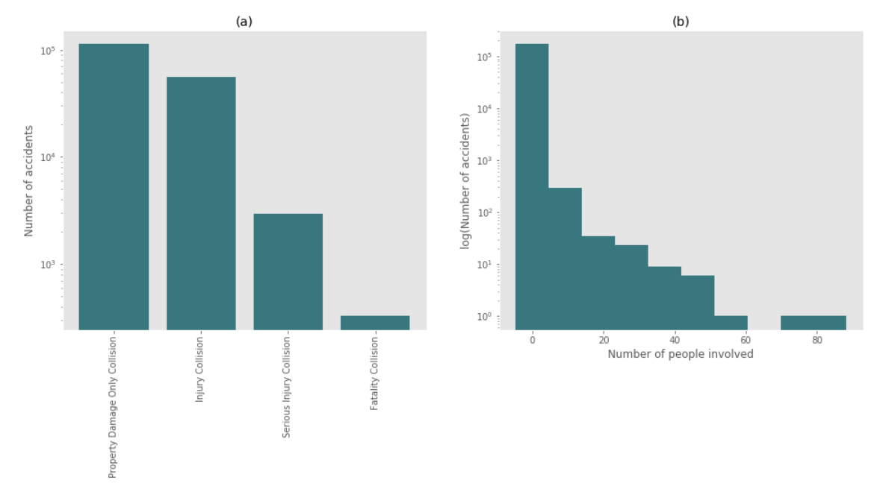
Accidents per Year
According to the graph above, from 2010 to 2013, there was a decrease in the number of accidents, however over the past few years there has been an increase in accidents, with 2016 being close to the 2010 numbers.

Slide 9
How do the available factors contribute to accident seriousness?
did_police_officer_attend_scene_of_accident
x1st_point_of_impact
number_of_vehicles
speed_limit
urban_or_rural_area
skidding_and_overturning
vehicle_leaving_carriageway
sex_of_driver
vehicle_type
vehicle_manoeuvre
engine_capacity_cc
number_of_casualties
driver_home_area_type
age_band_of_driver
junction_control
hit_object_off_carriageway
hit_object_in_carriageway
driver_imd_decile
junction_detail
junction_location
propulsion_code
year
These features were found to have the highest relation to accident seriousness. While they may all have an impact, not every feature will be discussed in the following slides. The features discussed will be based on the findings from their visualization. For visual reasons, two separate dataframes were created, for not serious and serious accidents. I wanted to better scale the data and for me, this was the simplest way of doing so.

Slide 10
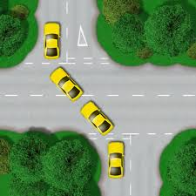
Possible Solution
From the data above more controlled areas would be beneficial. Maybe signs alerting drivers of the upcoming junctions, traffic lights, or stop signs would help in some of these areas where they are feasible.
For example, this is a staggered junction, the main junction detail in accidents. One can understand how a situation such as these can lead to numerous accidents especially if proper signage is not available. Perhaps traffic lights, stop signs, or warnings indicating that they are approaching certain junctions would help reduce accidents.

Slide 11
Expectations vs Reality
Expectation
Reality
Overall I thought there would be certain features that had a high impact on the severity of accidents.
skidding_and_overturning
time_of_day
weather_conditions
day_of_week
There were very low correlations among features and accident severity. The highest correlation was vehicle_type at 0.134.

Slide 12
Limitations
Not able to obtain accuracy over 70% without causing other issues such as overfitting and bias.
The data was extremely imbalanced. The majority of accidents were not serious and while this is not a real life problem, it was a problem for this model. Undersampling was done to improve overall scoring.
More factors surrounding accidents should be included in this data.
While there was information on the speed limit in certain areas, there was no information on whether the driver was speeding.
No information on cellphone usage of drivers
Rural areas had a higher rate of serious accidents which could be correlation to emergency vehicle arrival or distances from hospitals, but this information was also not available
No time of arrival for emergency units
No info on passengers
Low correlations

